Slide 1
Quiz Time- even years-
True or False
I was both a boy scout and a girl scout
I always got straight A’s in school
I can run a 5k in less than 25 minutes
I dissected a cat and a human in HS
I played soccer in high school
I was banned from bringing books to elementary school
My mom was my teacher in kindergarten
Notes:
Grab a post it note! Now you know a little bit more about me!
2012, 2014

Slide 2
Quiz Time-odd years
True or False
I went to Catholic schools my whole life
I have 32 aunts and uncles
I have traveled to all 50 states
I have taken classes at 6 different colleges
I have more pets than people in my house
I taught at a high school before coming to St. Luke
I like muscle cars and monster trucks
Notes:
Grab a post it note! Now you know a little bit more about me!
2013

Slide 3
Mrs. Ritter
FYI’s for your success!

Slide 4


Rule #1- Be Prepared
Pencil bag
Books
Composition notebook
Assignments
Assignment notebook
Replace things that are
lost or damaged!
You may not interrupt a class
to retrieve forgotten materials-
So you might need to get creative!
Stay calm & figure it out a reasonable solution

Slide 5

Rule #2 -Follow Procedure
Come in, sit down & get started!
The white board has:
What to get out,
what to write down
What to get started on-
the minute you step in the room!!
I should NOT
have to direct you to get started!
I should NOT
have to remind you to be quiet!

Slide 6
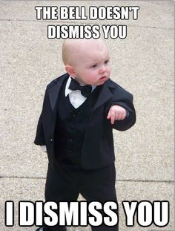
Rule #3-Use all class time wisely
A class in the hall
X
If you finish early:
Start homework
Study
Read a book
Organize materials
Talking or distracting other
learners is NOT OK!

Slide 7
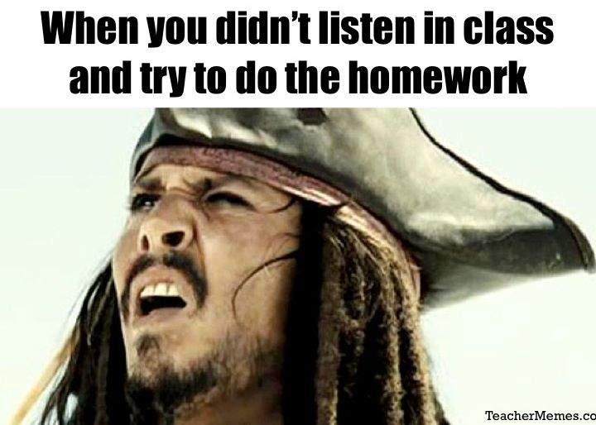
Rule #4- Engage
Learning is an ACTION
It is something you DO
It is not something you RECEIVE
You will be prepared
To accomplish
any task
IF you:
Participate and ask questions in class,
Make notes as you correct practice work
Look over and start homework in class

Slide 8
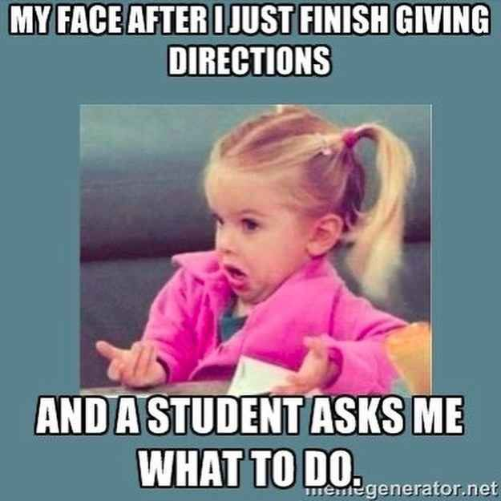
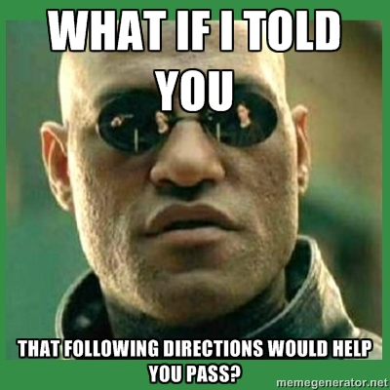

Rule #5- Listen & follow directions!
Sometimes, the process
IS the learning experience!
Yep, true story . . . .

Slide 9

Rule # 6 Own your learning
Before you say “ I’m through”
ASK YOURSELF:
    Did I do my best?
    Did I include everything that was required? Did I check the success criteria?
    Did I seek, listen to, accept and use peer/teacher/parent feedback?
    Is there anything I can improve?
    Is there a way for me to go above and beyond?
    Am I satisfied that this is the best I can do?

Slide 10



Rule #7- Fix your mistakes

Slide 11

Pet Peeves
Do not throw anything in the classroom
Do not touch other peoples’ things
Cover your book and KEEP IT COVERED!
Do not put marker or ink on your school materials OR your person!
Do not talk when I am talking

Slide 12


Slide 13







Materials
Composition notebook- NAME and HR on FRONT
Composition notebook- NO TEAR OUTS
PENCIL PREFERED- If you use pens need to be black or blue, preferably erasable
Ruler always ready
Loose leaf always college ruled with no fringes
HIGHLIGHTERS always with you
Calculators always ready
Red Pens to correct
x

Slide 14


Books
Write your name and year in PEN in the front cover of the book
Cover the book and keep it covered ( book socks are fine as long as they fit properly) do not tape to the book
* paper cover directions can be found online- google it!!
Do not write anything on book cover except name, class & HR
If cover becomes damaged- REPLACE IT- after due date- 5 pts a day until covered, periodic checks throughout the year and you could lose more!!!!

Slide 15

Heading your paper
Date full name, HR, period
assignment with page # or wkst title

Slide 16
A personal tour
Pencil sharpener
Late/absent box turn in, no name papers, absent work pick up boxes
Hole punches and other borrow-ables
Mailbox
Trade books, magazines
Shelves/cabinets/sinks are OFF LIMITS unless you ASK
Back room is OFF limits
Student desks and lockers are off limits
Bell ringer bins, white board procedure

Slide 17



Drills-
Fire, tornado, lock down
Fire and tornado- I lead, kids in Miss Gonet’s room and my room walk side by side down stairs and follow me- out the door or to the locker room. Silence and hands to self AT ALL TIMES
Lock down- lights off, door closed, everyone files into back room, silent and hands off!!

Slide 18
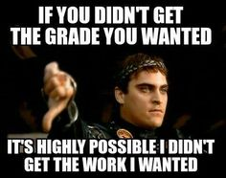
Grading
25% homework, bell-work, check-tests
25% group work and participation
50% quizzes, test and independent projects
There will be an 8th English midterm and 7th science mid term
There will be skill assessments for 8th grade end of year in vocab, grammar, and Science
Extra credit- only what is offered- take it when you can get it, I don’t do end of quarter grade buffers
Notes:
Homework assignments always count and are always checked, however some will be credited under homework and some as participation. The distinction depends on the level of work expected- some is introduction, some is practice and some is application. Bell work always counts as homework or participation as well for the same reasons. Quizzes and check tests assess a smaller portion of a chapter or unit. Some check tests are open note.
Occasionally, you will complete assignments with a partner. These assignments, along with completing work on time and class participation make up the participation grade. Finally, 50% of the grade is tests and projects

Slide 19


Late or absent
Late work – blue slip required! 2 additional points lost if you do not have a blue slip completed!
Generally, practice work is not accepted late. Graded work turned in before school the following day is reduced by 10%, a full day late 50% and is recorded as a zero after 1 week. This includes absent work that is not turned in promptly. There are, however, exceptions and exclusions depending on the situation and assignment.
Absence-you need to be responsible for getting what you missed, HOWEVER you MAY NOT interrupt the rest of the class to do this (appropriate times include before school, during snack time, during lunch time, after the class has settled into independent work or after school- NOT AT THE BEGINNING OF CLASS) Always check the absent bin first!
I will not typically give make up tests during class- you must schedule a time to come in before or after school, or during study hall- plan for at least 40 minutes, you cannot start a test and finish it at a later point!

Slide 20

Rest Room Passes
1 set per quarter, maximum of 4- they are not transferable to other students or to other teachers’ classes!!
Times to go to restroom
  Before school
  After you sign in and quickly gather your supplies but before we head to class
  During snack
  When you change for gym
  On your way to lunch
  At the end of the day after you have been dismissed from your last class

Slide 21

Uniforms
Pink slips returned next day or participation points are lost
The focus is simple- as a Catholic school student, your unique gifts given to you by God are all from within. No where in your faith are you encouraged to define yourself by your appearance
Take advantage of this break from the secular and focus on developing your unique gifts
Take care- after you receive 3 pink slips, you may lose out of uniform privileges !!!

Slide 22
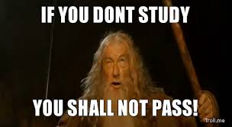
Study Help
Recognition is seeing the what is familiar but it is harder to use and is usually lost- students who study by “reading over” their book and worksheets are often frustrated because they feel prepared for a test but are not as successful because they recognize the content but are not prepared to use it!
Knowledge can be applied and carried over to new situations. It requires action- students need to Reflect on each lesson, jotting down notes and reviewing until it can be explained in the student’s own words. Students need to Repeat the review process regularly until it can be Recalled from memory- this moves ideas from short term to long term memory. Students need Apply knowledge at every opportunity so they can determine what they know and don’t know so they can ask questions and clarify.
Tips and tricks are stressed constantly in class- this transition from recognition to knowledge is hard, but is necessary for success!

Slide 23


Contact me!
Email- use address from St. Luke Website
Notes can be written and put in my mailbox
I am usually here by 7:40 each morning and stay until 3:45 each evening- but check in advance if you plan to stay after
Website has lots of resources- check it out!

